Slide 1
Operation Analytics and Investigating Metric Spike

Slide 2
Project Description:
The project is analyzing the complete end to end operation of a company to predict the overall growth or decline of a company’s fortune.
Approach:
The project is executed with the help of dataset that is provided.
Tech- Stack Used:
For the execution of the project DB My SQL 8.0 was used.
Insights:
The database I got faced little issue with the data type of colums where dates are given in text format.So I have changed my querry code several times , so it took more time to complete the project.

Slide 3
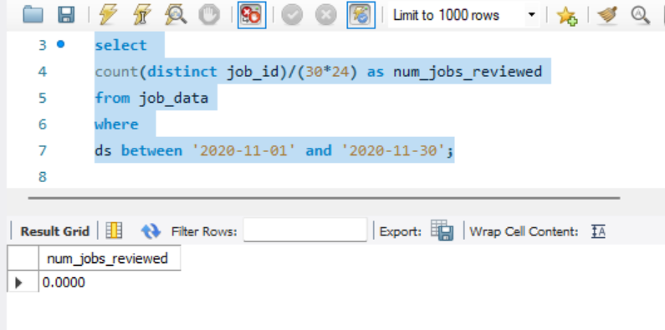
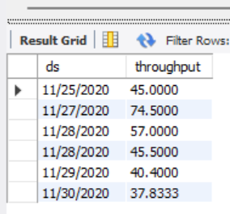
Case Study 1: Job Data Analysis
Jobs Reviewed Over Time:
select count(distinct job_id)/(30*24) as num_jobs_reviewedfrom job_datawhere ds between '2020-11-01' and '2020-11-30';
2.Throughput Analysis (7-day rolling average):
SELECT ds, AVG(time_spent) OVER (ORDER BY ds ROWS BETWEEN 6 PRECEDING AND CURRENT ROW) AS throughputFROM job_dataWHERE event IN ('transfer', 'decision');

Slide 4
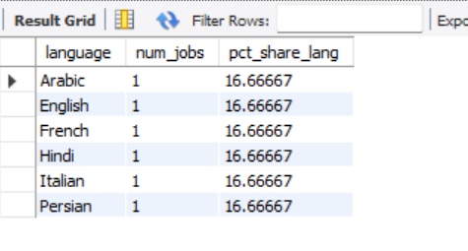
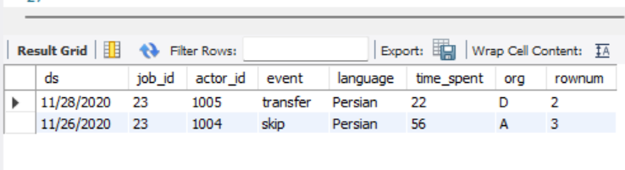
Explanation for Throughput Analysis:
I prefer using the 7-day rolling average of throughput because it provides a smoother trend over time, eliminating daily fluctuations and giving a better representation of the overall performance. It helps in identifying long-term patterns and makes it easier to spot significant changes in throughput.
Language Share Analysis:
select language, num_jobs, 100.0* num_jobs/total_jobs as pct_share_langfrom( select language, count(distinct job_id) as num_jobs from job_data group by language )across join ( select count(distinct job_id) as total_jobs from job_data)b;
4.Duplicate Rows Detection:
select * from(select *,row_number()over(partition by job_id) as rownum from job_data)a where rownum>1;

Slide 5
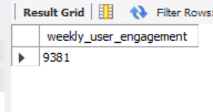
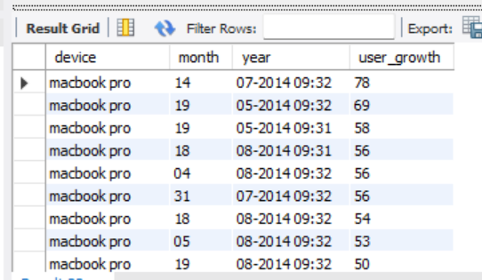
Case Study 2: Investigating Metric Spike
Weekly User Engagement:
select count( user_id) as weekly_user_engagement from users where activated_at < NOW()-interval 1 week and state ='active’;
2. User Growth Analysis:
SELECT device, SUBSTRING(occurred_at, 1, 2) AS month, SUBSTRING(occurred_at, 4) AS year, COUNT(user_id) AS user_growth FROM events GROUP BY device, month, yearORDER BY user_growth DESC;

Slide 6
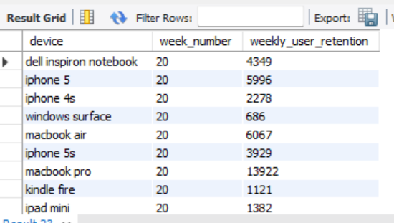
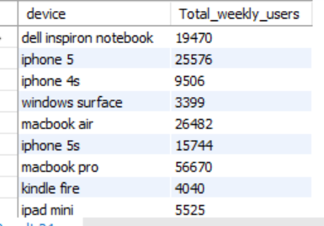
3.Weekly Retention Analysis:
SELECT device, WEEK(STR_TO_DATE(occurred_at, '%Y-%m-%d')) AS week_number, COUNT(user_id) AS weekly_user_retentionFROM eventsWHERE occurred_at IS NOT NULL AND STR_TO_DATE(occurred_at, '%Y-%m-%d') IS NOT NULL GROUP BY device, WEEK(STR_TO_DATE(occurred_at, '%Y-%m-%d’));
4.Weekly Engagement Per Device:
SELECT device,COUNT(user_id) AS Total_weekly_usersFROM eventsWHERE occurred_at < NOW()-INTERVAL 1 WEEKAND event_type = 'engagement'GROUP BY device;

Slide 7
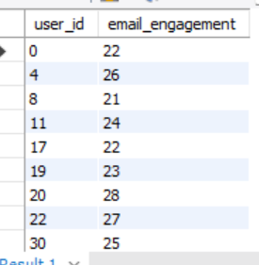
5.Email Engagement Analysis:
SELECT user_id, COUNT(*) AS email_engagementFROM email_eventsGROUP BY user_idORDER BY user_id;
Results:
These SQL queries should help you perform the specified tasks in the Job Data Analysis case study.

